Slide 1

CoPilot Safe Assist
Software Engineering 2: Project Teamwork Mälardalen University
Optimus Octavian

Slide 2
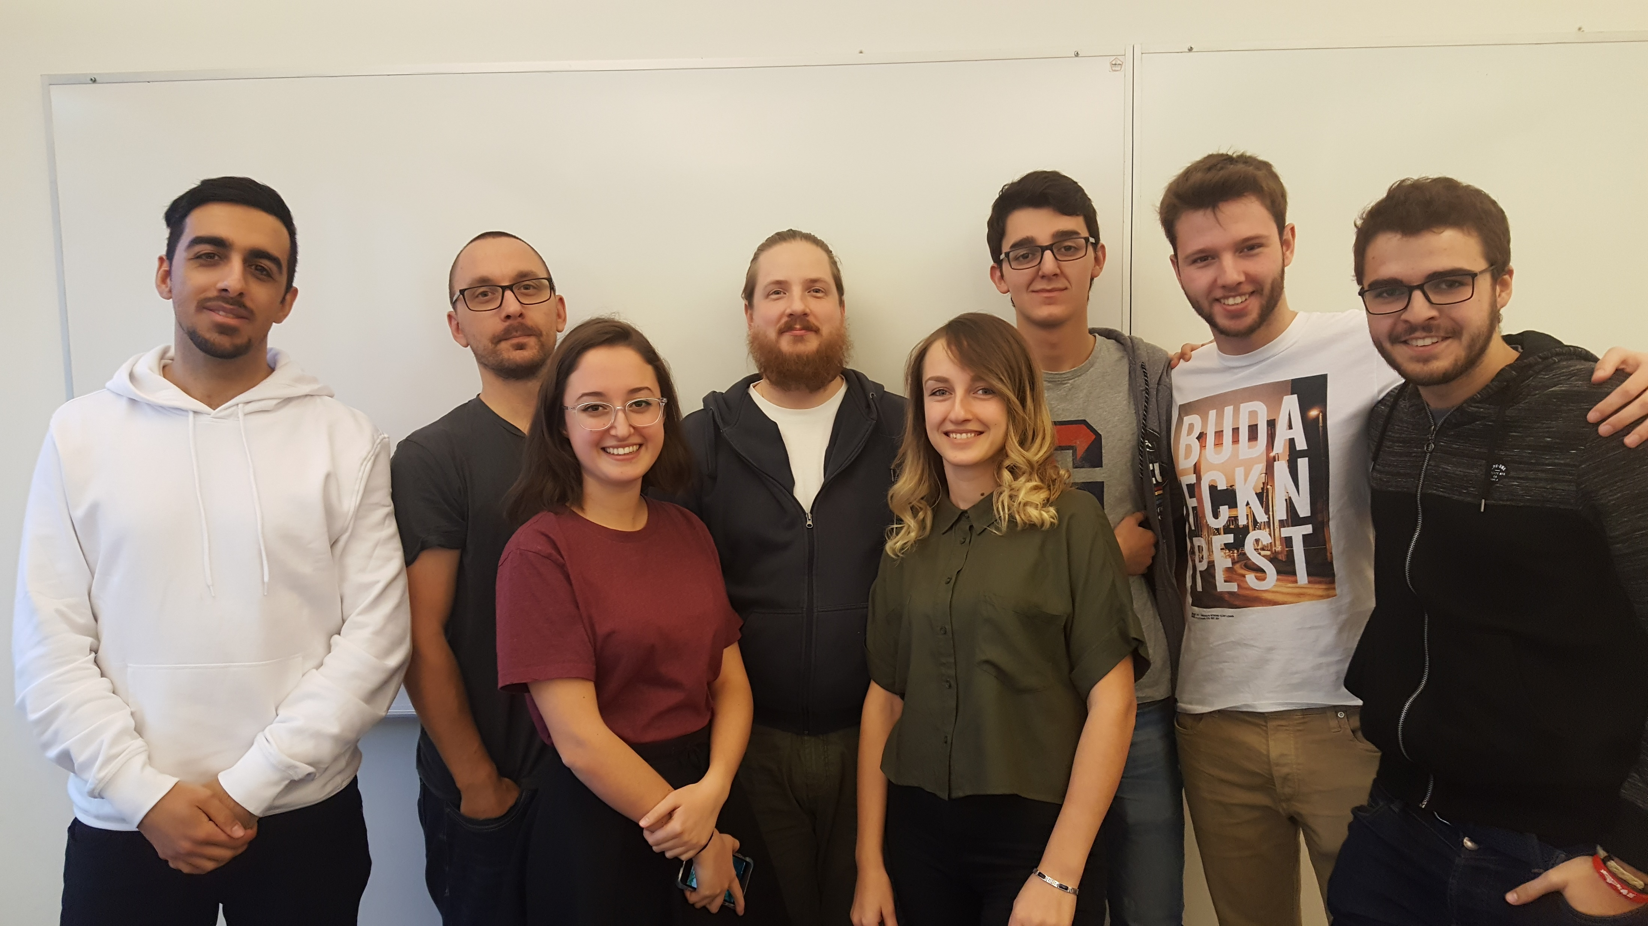
The north remembers… (briefly)

Slide 3
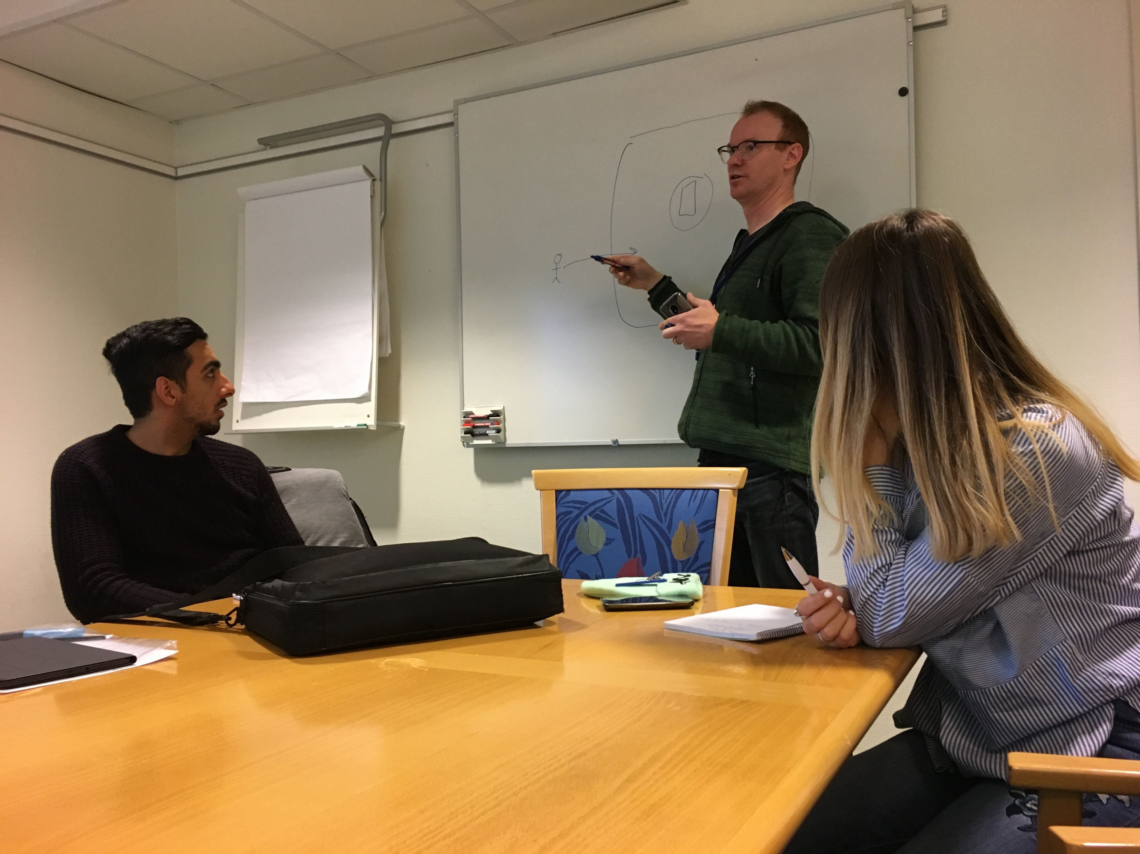
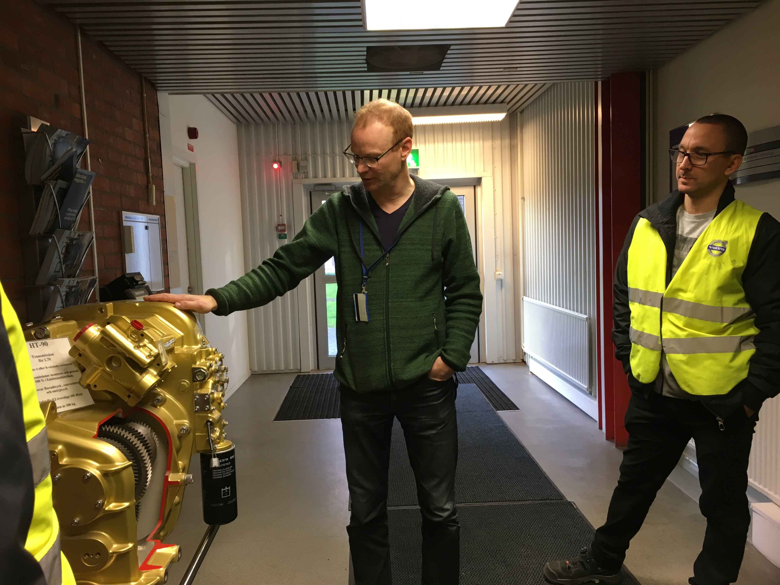
The north remembers… (briefly)

Slide 4
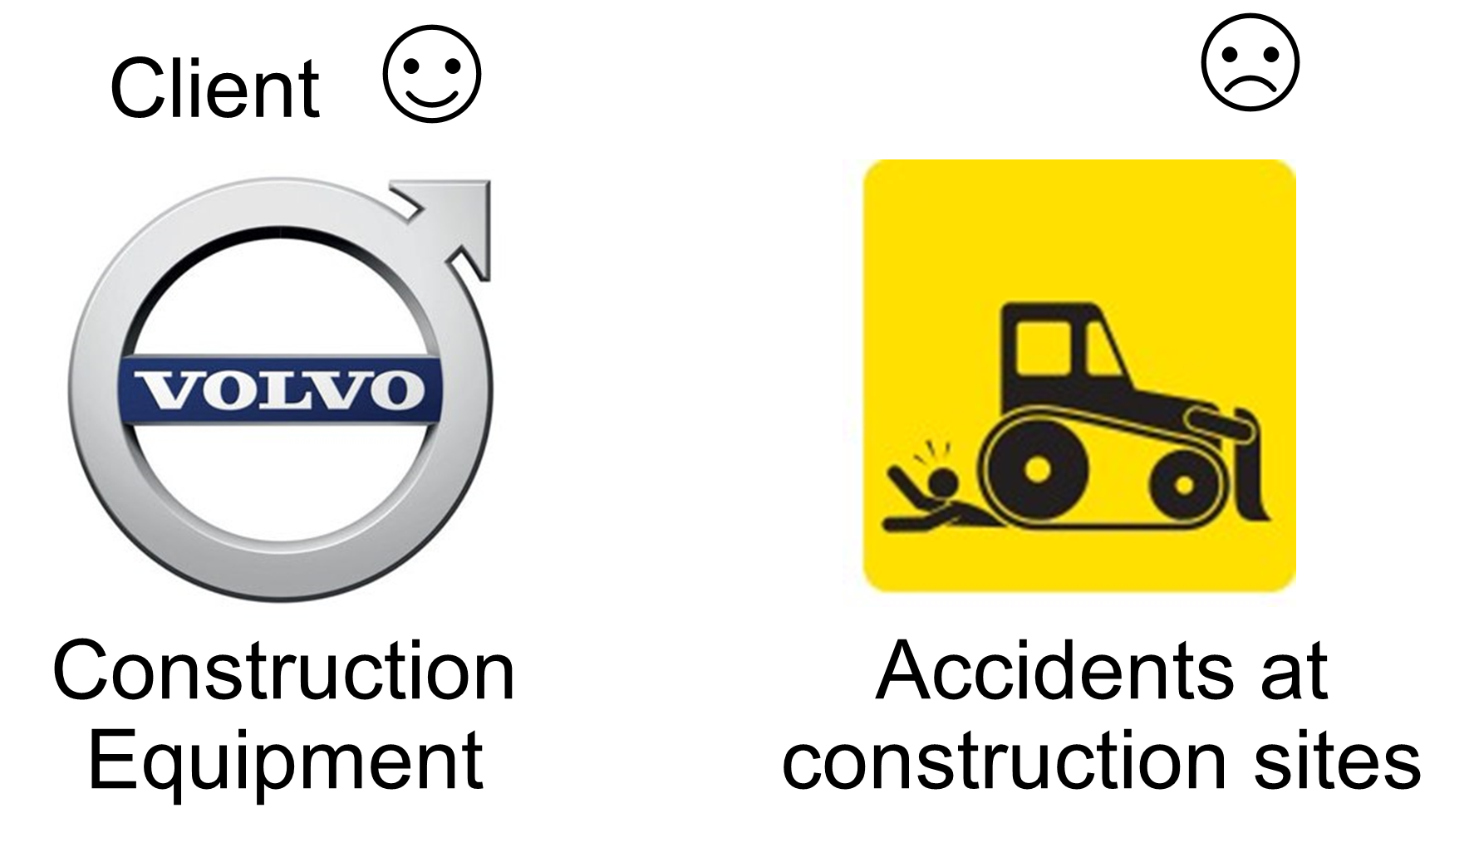
The north remembers… (briefly)
Problem

Slide 5
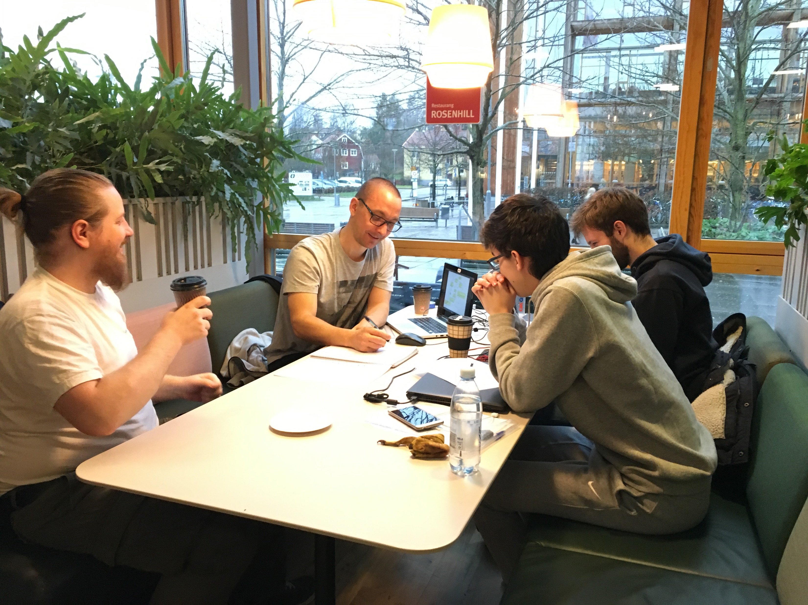
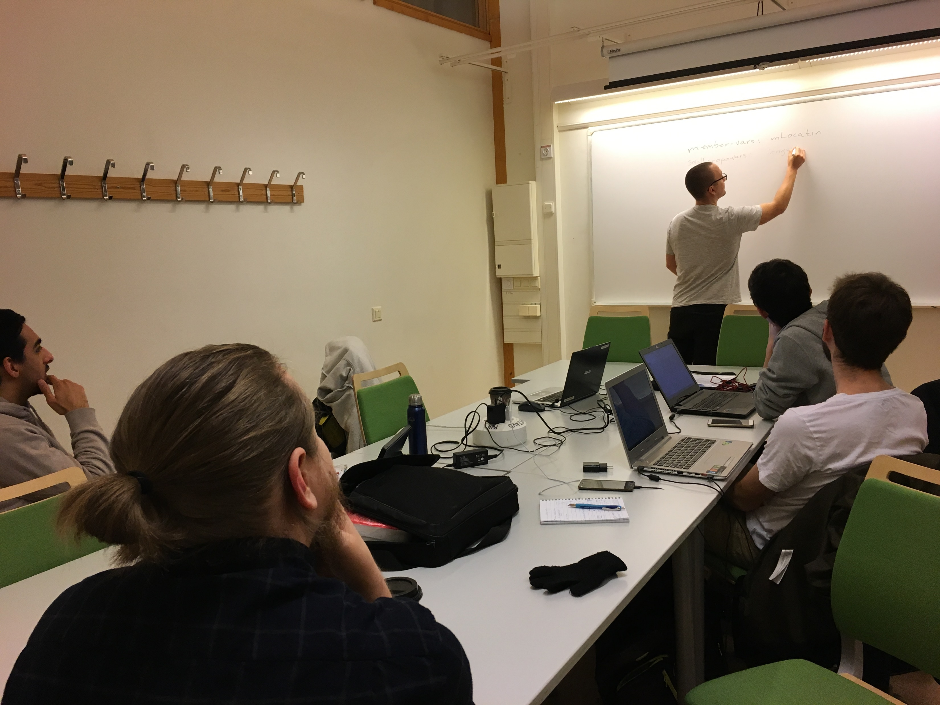
Important events and changes

Slide 6
Important events and changes
EVERYTHING

Slide 7
Important events and changes
We started doing the high-level design…

Slide 8
Important events and changes
We started doing the high-level design… but we had to redo many things

Slide 9
Important events and changes
We started doing the high-level design… but we had to redo many things
Class diagram
Sequence diagram
Use case diagram
Database diagram
System architecture

Slide 10
Important events and changes
We started doing the high-level design… but we had to redo many things
Class diagram
Sequence diagram
Use case diagram
Database diagram
System architecture
AGILE!

Slide 11
Implemented features
On a prototype level
GUI
App-server connection
Simulated database
Simulated server

Slide 12
Implemented features
On a prototype level
GUI
App-server connection
Simulated database
Simulated server
Final application
We are working on it right now!

Slide 13
High-Level Architecture
Tiered-Client-Server
Server-Client with Model View Controller in the client
MVC with a connection to server
Notes:
- I know few people who like to design more than implement (maybe it's because I study Computer Science), but well, we have to do it.... So… We have been shuffling several architectures as you can see

Slide 14

High-Level Architecture
Tiered-Client-Server
Server-Client with Model View Controller in the client
MVC with a connection to server
Notes:
-In the tier client/server, most of the application logic and data is hosted on a server but we decide we needed an independent view to show the different data and the possibility to add more views

Slide 15
High-Level Architecture
Tiered-Client-Server
Server-Client with Model View Controller in the client
MVC with a connection to server
Notes:
-It seemed to us that it was overlooked having a MVC inside the client

Slide 16
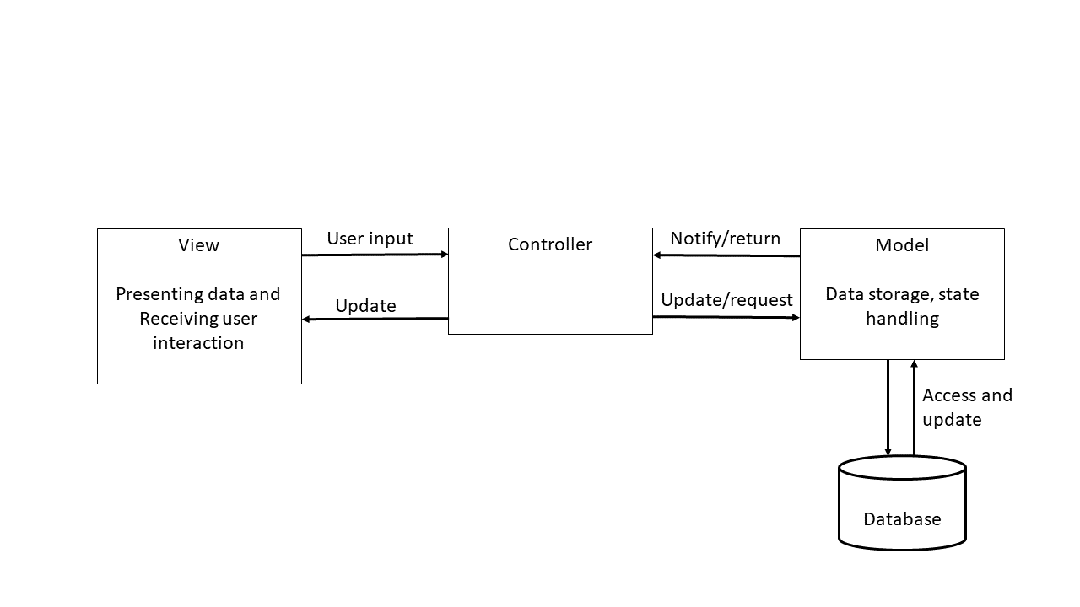
And the winner is…
-MVC with a connection to server
Notes:
-In order to centralize the operations in the server but keeping a client active, we proposed an MVC with a connection to server:
-View: User Interface
-Controller: Will process all the info provide by the client
-Model: Will store the current status and the data resulted in the operations

Slide 17
What motivated the design?
The DB not be able to store data of the workers
Co-Pilot has API 15
The workers and operator must provide location
Notes:
- ”The DB not be able to store data of the workers”: We talk about personal data that could be stolen
“Co-Pilot has API 15”: Android 4.0.3 (Ice Cream Sandwich)
“The workers and operator must provide location”: To be able to calculate the location of the Units every moment (but only inside the construction site (safety feature))

Slide 18
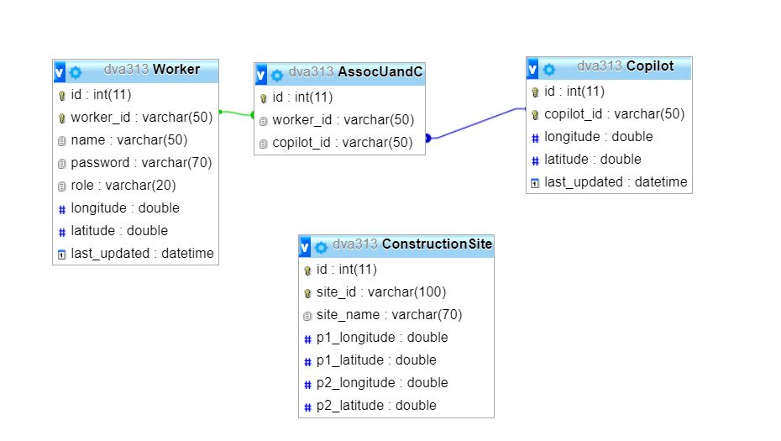
Being the DB like…
Notes:
-Here we can see the structure of the DataBase that will store some important information like:
-The association between the Worker and the Co-Pilot (that Will be an Operator Machine?)
-The Construction Site info where all will happens

Slide 19
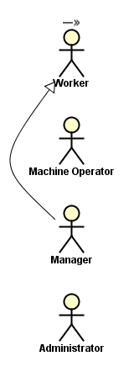
Who are the actors?
Will work in the Construction Site
Will work in a machine (with Co-Pilot)
Will manage all about the Construction Site (Inside the Construction Site)
Will manage the workers
(Outside the Construction Site)

Slide 20
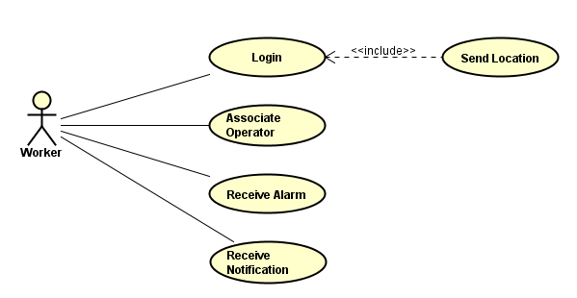
Worker
Notes:
If you log in, you send your location to the server automatically
Associate operator (to a machine)
Receive alarm (in a dangerous situation)
Receive notification (for notice the worker of things like: “Be careful!! You are in a Construction Site”)

Slide 21
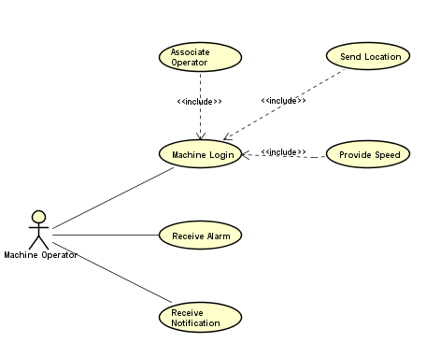
Operator Machine
Notes:
- If a machine operator logs in, its handleDevice must be associated to the Co-Pilot (because, if not, it will be receiving notifications and alarms all the time because in inside the vehicle so… is inside the vehicle dangerous range) and also, like the worker, it will send its location to the server automatically but, also its speed since speed is important in calculations
Receive alarm (in a dangerous situation)
Receive notification (for notice the worker of things like: “Be careful!! You are in a Construction Site”)

Slide 22
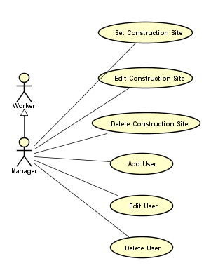
Manager
Notes:
Set, Edit and Delete the Construction Site where all will happens…
Add, Edit, Delete user: For temporally situations as a worker cannot work today because is sick or somthing like that, to do this in a long period there is…

Slide 23
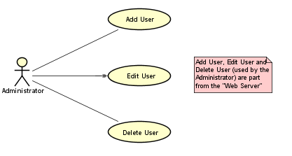
Administrator
Notes:
… that will do the same but not in the application as you will see after (NO SPOILERS). It will add, edit and delete users for a long period.
-This part belongs to the “Web Server” Side

Slide 24
What is doing what?
-Handheld Device & Co-Pilot: Provide Location and listening to notifications and alarms
-Server: Calculate locations and send notifications and alarms to handheld devices
Notes:
Handheld Device: That is the phone of the workers and the Co-Pilot integrated in the machines (listening all the time to notifications and alarms to ensure… that it will not die)
Server:

Slide 25
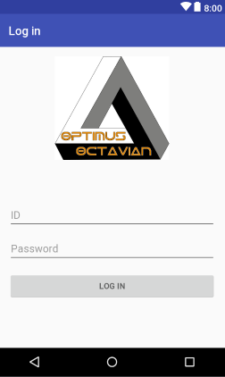
GUI

Slide 26
GUI
Notes:
Hablar de la decisión de colores y de fases de peligro

Slide 27
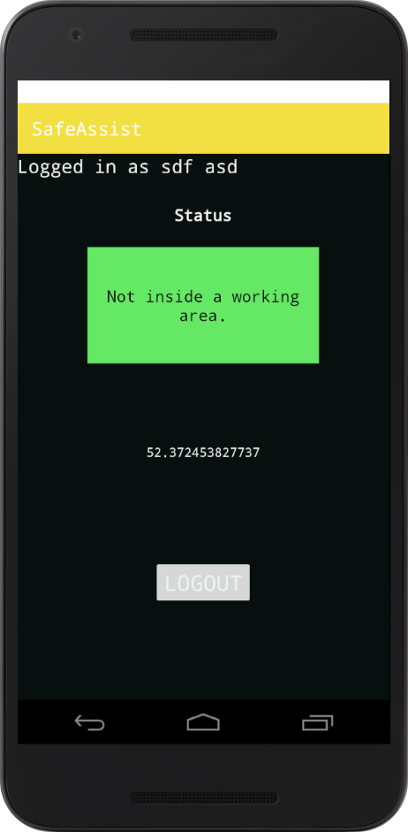
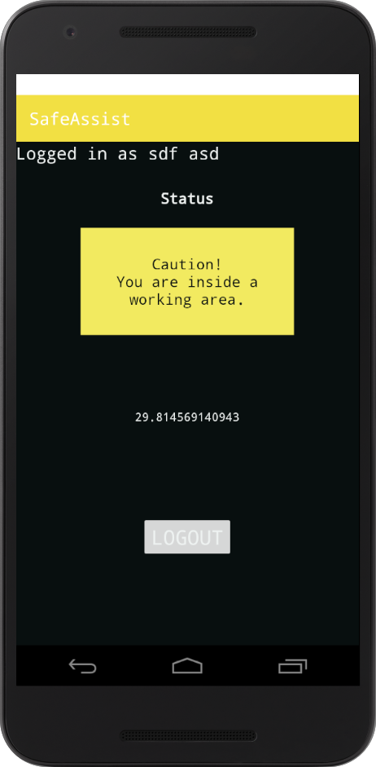
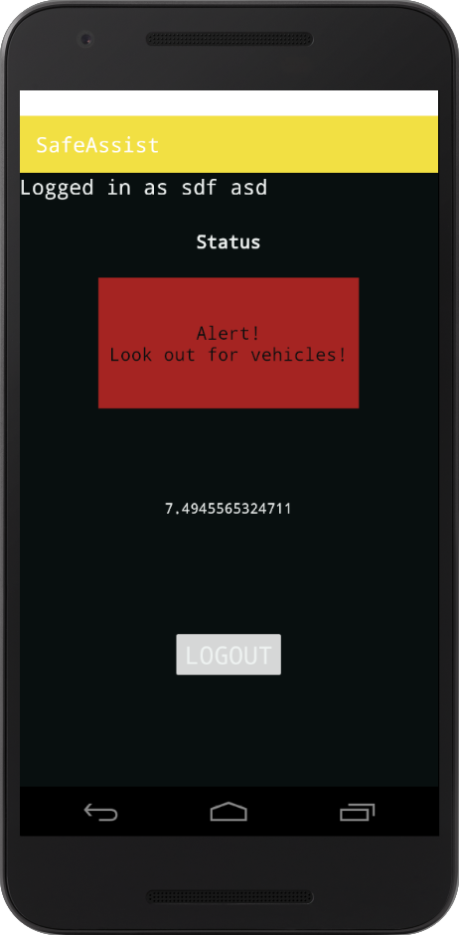
Demo Screenshots

Slide 28
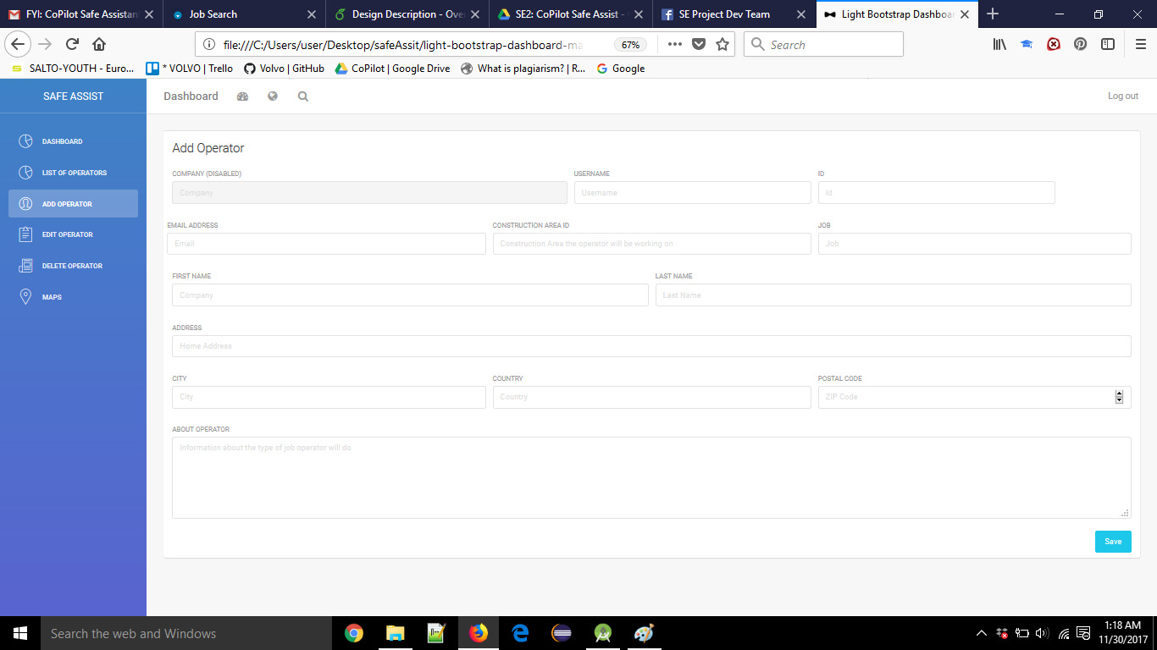
Web GUI

Slide 29

Remaining Time
We will implement
We will test

Slide 30
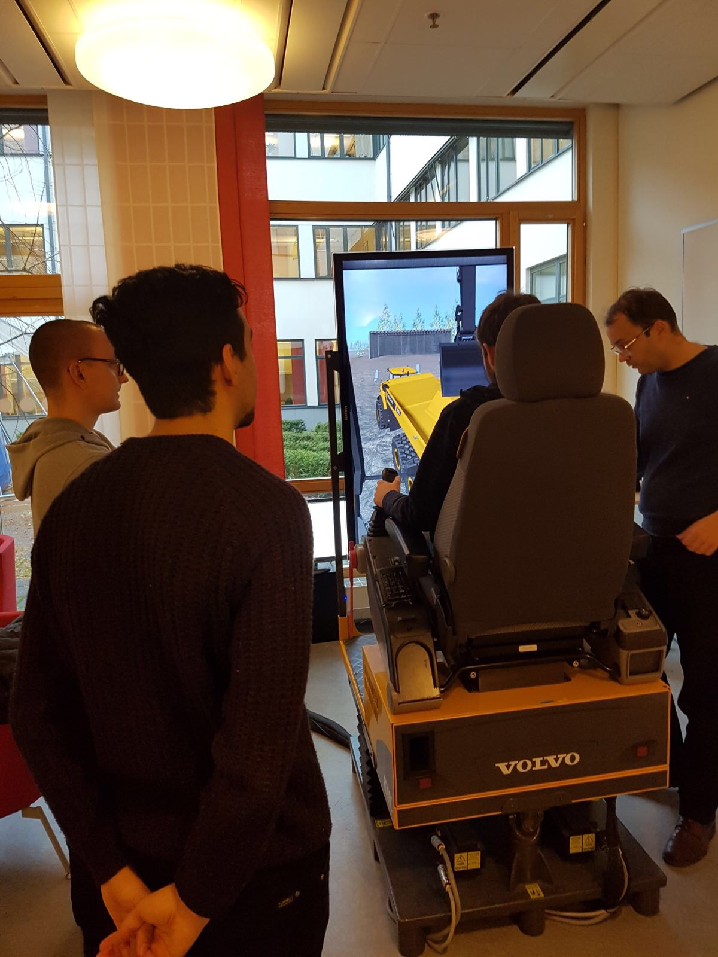
Required for testing
We are waiting for MDH contact instructions.
We will have another meeting with the client on Skype.
We will have a meeting before Christmas with the representatives of Volvo to revise the code.

Slide 31
Some ideas
Multiple construction areas.
A map from above.
Emergency button.
Mutable alarms.

Slide 32


